Slide 1
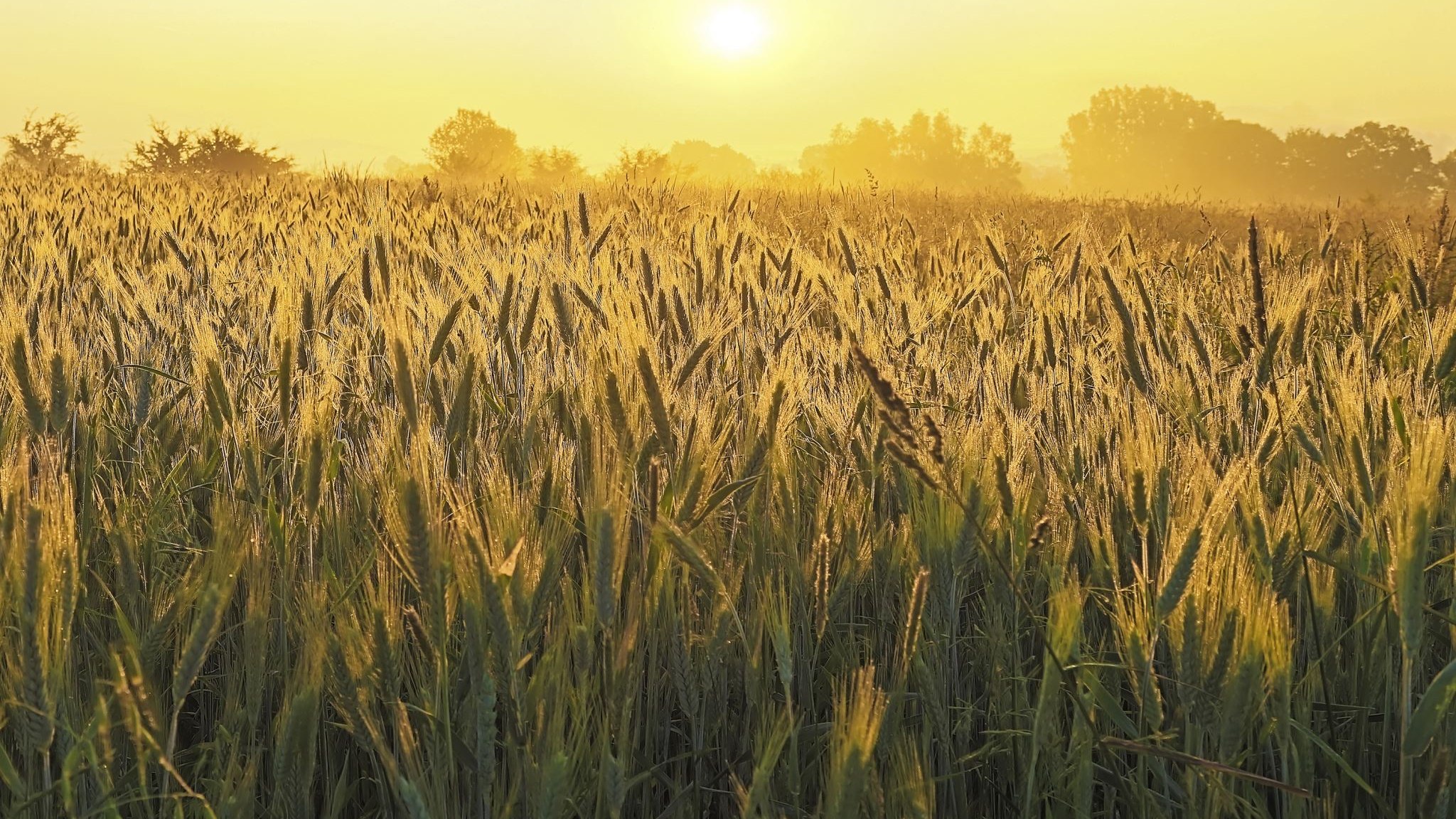
Green Fields, Smart Yields: Precision Agriculture Empowered by LoRa Wireless Sensor Networks
Bachelor of Technology (B. Tech.)
Computer & Communication Engineering
19ECE436 – Wireless Sensor Networks

Slide 2
Area of Research: Integration of LoRa Technology in Precision Agriculture
Context and Motivation
Precision agriculture responds to urbanization and resource scarcity challenges
LoRa technology integration explored as a transformative solution
Scope and Coverage
Examination of LoRa's role in precision agriculture
Discussion of prospects, applications, and system models
Analysis of methodology, hardware, and software requirements
Urbanization and Agricultural Imperatives
Urbanization demands sustainable food production solutions
LoRa bridges traditional farming and modern urban challenges
Comprehensive Exploration
Beyond technology, inquiry extends to applications and models
Methodology establishment and essential prerequisites covered
Resilient Framework Creation
Integration for adaptable and data-driven agriculture
Wireless connectivity and real-time insights redefine farming

Slide 3
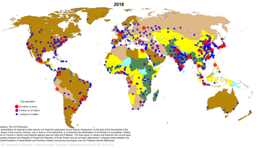
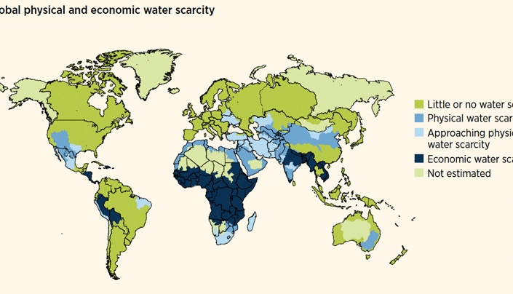
Problem Identification: Urbanization and Agricultural Challenges
Global Urbanization – A significant challenge arises from the projected urban population surge, with an estimated 50% of the global population expected to reside in urban areas by 2050.
Resource Scarcity – As urbanization accelerates, concerns intensify regarding the availability of essential resources such as food and water, amplifying the need for sustainable agricultural practices.
Indian Context – The situation is particularly pertinent in India, where ineffective irrigation practices contribute to a looming freshwater deficit by 2050, underscoring the urgency for innovative solutions.
Inefficient Agriculture – Conventional agricultural methods struggle to cope with the evolving demands of urbanization, highlighting a critical gap between established practices and the contemporary urban landscape.
Need for Innovation – The widening disparity between traditional farming approaches and the complexities of urbanization necessitates pioneering interventions to harmonize resource allocation and agricultural viability within this changing context.

Slide 4
Title | Authors | Journal Details | Methodology | Limitations and Future scope
AgriFusion: An Architecture for IoT and Emerging Technologies Based on a Precision Agriculture Survey | R. K. Singh, R. Berkvens and M. Weyn | IEEE Access, vol. 9, pp. 136253-136283, 2021 | Data Analysis: Reviewed Precision Agriculture literature with a focus on Wireless Sensor Networks, IoT, AI, ML. Analyzed various sources, including IEEE publications. Technology Integration: Explored and classified emerging technologies for PA. Proposed AgriFusion, an integrated architecture mapping technologies to IoT layers. Performance Evaluation: Introduced a step approach for designing Key Performance Indicators (KPIs) in PA. Compared industrial solutions, aligning them with focused technologies. | Acceptance Challenges: Identified challenges related to IoT solution acceptance by farmers. Emphasized the need for transparent policies. Technology-Specific Challenges: Addressed challenges in ML algorithm computation power. Recognized the necessity for developing lightweight ML and AI algorithms. Future Research Directions: Outlined future research directions for sustainable PA. Explored Agriculture 6.0, integrating technologies for production and environmental goals.
Internet of Things for Agricultural Applications: The State of the Art | T. Ojha, S. Misra and N. S. Raghuwanshi | IEEE Internet of Things Journal, vol. 8, no. 14, pp. 10973-10997, 15 July15, 2021 | Analysis of IoT Applications: Examined IoT agri-solutions with design and implementation details. Reviewed IoT experimentation tools in agriculture. Identification of Open Issues: Listed challenges and limitations in enabling IoT for agriculture. Analyzed general issues in current systems. | Energy and Power Management: Discussed managing IoT device power and energy. Emphasized smart techniques and alternate energy use. Ease of Deployment: Stressed IoT systems' diverse deployment ease. Considered end users with limited tech knowledge. Security: Recognized IoT agri-system vulnerability. Stressed end-to-end security provisioning.
The digitization of agricultural industry – a systematic literature review on agriculture 4.0 | Rabiya Abbasi, Pablo Martinez, Rafiq Ahmad | Smart Agricultural Technology, Volume 2, 2022, 100042, ISSN 2772-3755 | Digital Technologies Analysis: Explored adoption patterns in agriculture. Analyzed service types, technology levels, and farm preferences. Focused on autonomous robotic systems, IoT, and machine learning. Identification of Roadblocks: Classified technical and socio-economic challenges. Addressed potential hurdles to Industry 4.0 implementation in farming. | Current Status of Digital Technologies: Emphasized early-stage integration of technologies. Advocated further research on maturity and functionality. Added Value of Digital Technologies: Recognized benefits like enhanced yields and cost reduction. Encouraged ongoing research for more insights. Future Work: Suggested wider database inclusion. Proposed expansion to cover agriculture 5.0 and broader digitization aspects.
IoT-Equipped and AI-Enabled Next Generation Smart Agriculture: A Critical Review, Current Challenges and Future Trends | S. Qazi, B. A. Khawaja and Q. U. Farooq | IEEE Access, vol. 10, pp. 21219-21235, 2022 | Survey: Conducted a thorough survey on smart agriculture, exploring IoT and AI advancements. Analysis: Examined hardware/software components, focusing on IoT nodes, wireless tech, and AI applications. Future Trends: Explored emerging trends like edge AI, 5G, and blockchain in smart farming. | Challenges: Addressed tech challenges (standardization, compatibility, cost) for wider adoption. Social Impact: Recognized the need for farmers to adapt to tech changes. Data Formats: Identified issues with diverse data formats, suggesting solutions.

Slide 5
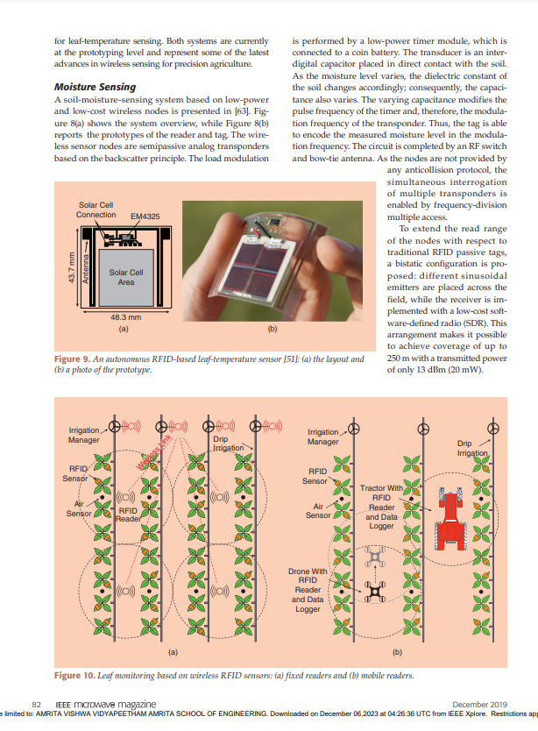
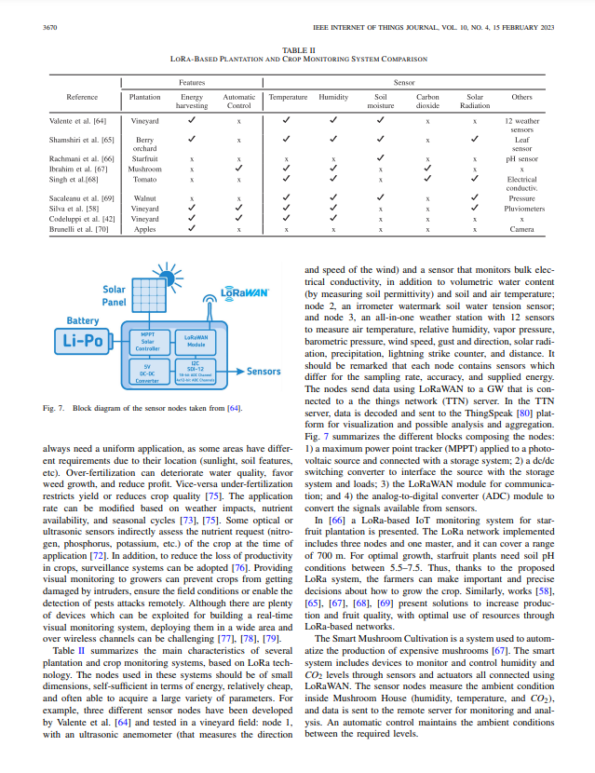
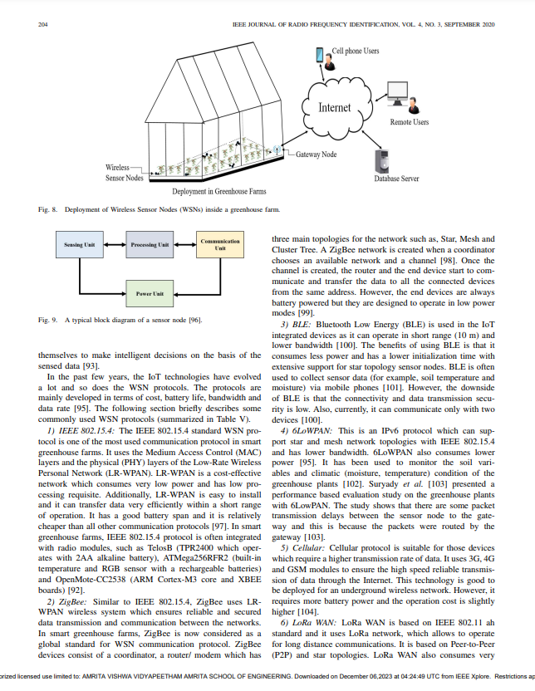
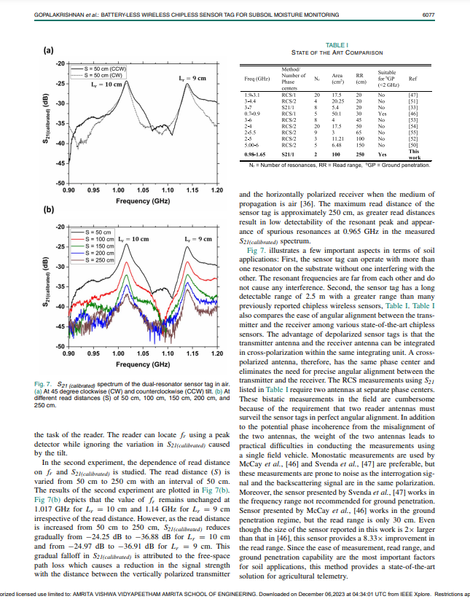
References
S. Gopalakrishnan, J. Waimin, N. Raghunathan, S. Bagchi, A. Shakouri and R. Rahimi, "Battery-Less Wireless Chipless Sensor Tag for Subsoil Moisture Monitoring," in IEEE Sensors Journal, vol. 21, no. 5, pp. 6071-6082, 1 March1, 2021, doi: 10.1109/JSEN.2020.3039363.
R. Rayhana, G. Xiao and Z. Liu, "Internet of Things Empowered Smart Greenhouse Farming," in IEEE Journal of Radio Frequency Identification, vol. 4, no. 3, pp. 195-211, Sept. 2020, doi: 10.1109/JRFID.2020.2984391.
V. Palazzi, S. Bonafoni, F. Alimenti, P. Mezzanotte and L. Roselli, "Feeding the World With Microwaves: How Remote and Wireless Sensing Can Help Precision Agriculture," in IEEE Microwave Magazine, vol. 20, no. 12, pp. 72-86, Dec. 2019, doi: 10.1109/MMM.2019.2941618.
A. Pagano, D. Croce, I. Tinnirello and G. Vitale, "A Survey on LoRa for Smart Agriculture: Current Trends and Future Perspectives," in IEEE Internet of Things Journal, vol. 10, no. 4, pp. 3664-3679, 15 Feb.15, 2023, doi: 10.1109/JIOT.2022.3230505.

Slide 6
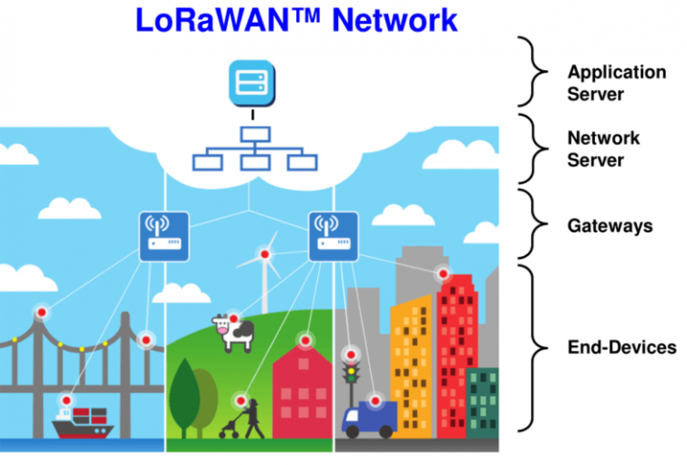


Project Objectives
LoRa Integration – Seamlessly integrate LoRa technology into precision agriculture systems for efficient data communication.
Real-Time Data – Establish wireless sensor networks for real-time collection of crucial agricultural data.
Dynamic Analysis – Utilize collected data for dynamic analysis to provide actionable insights for informed decision-making.
Resource Optimization – Optimize resource utilization in agriculture by implementing data-driven strategies that enhance efficiency and sustainability.

Slide 7
Hardware & Software Tools
Serial Number | Item | Purpose | Quantity | Unit Price
1 | Arduino Uno Boards with Cable | Microcontroller platform for data processing and control | 2 | Rs. 627.84 X 2 = Rs. 1,255.68/-
2 | SX1278 LoRa Series Ra-02, Spread Spectrum Wireless, Module | Long-range communication modules for transmitting data wirelessly over long distances | 2 | Rs. 385 X 2 = Rs. 770/-
3 | LoRa Antenna – 433 MHz | Facilitate long-range and low-power communication between wireless sensor nodes | 2 | Rs. 55 X 2 = Rs. 110/-
4 | RF 1.13 mm Cable IPX to SMA Female – 10cm Length | Connecting components within the LoRa wireless sensor network | 2 | Rs. 44.50 X 2 = Rs. 89/-
3 | DHT-11 Digital Temperature And Humidity Sensor | Measures temperature and humidity, providing essential data for precision agriculture | 1 | Rs. 190/-
4 | Passive Infrared (PIR) Motion Sensor | Strategically deployed in the agricultural field to detect and respond to motion | 1 | Rs. 69/-
5 | HC-SR04 5V Ultrasonic Sensor | To measure distances in the field, facilitating precise monitoring and management of agricultural resources | 1 | Rs. 55/-
6 | TowerPro MG995 Metal Gear Servo Motor (180° Rotation) | Precise mechanical control within the agricultural system | 1 | Rs. 320/-
4 | LCD1602 Parallel LCD Display with Blue Backlight | Displays real-time temperature and humidity data for on-site monitoring | 1 | Rs. 116/-
5 | Jumper Wires Cable Set | Essential for connecting components and building the circuit | - | Rs. 60/-
6 | GL-12 840 Points Solderless Breadboard | Provides a platform for prototyping and assembling the circuit | 2 | Rs. 59 X 2 = Rs. 118/-
9 | Arduino Programming Software | Develops and uploads code to the Arduino boards for their operation | Open-Source Software Tools
10 | LoRa Communication Libraries | Provides essential functions to implement LoRa communication capabilities
Total |  |  |  | Rs. 3,152.68/-
Please note that the prices mentioned are approximate and can vary based on the brand, supplier, and location.

Slide 8
Programming Methodology – LoRa Sender
Libraries:
`SPI.h`: Enables SPI protocol communication.
`LoRa.h`: Facilitates LoRa communication.
`"DHT.h"`: Supports DHT sensor data reading.
`Servo.h`: Controls servo motors.
Constants & Variables:
`DHTPIN` and `DHTTYPE`: Define DHT sensor details; `dht`: DHT sensor object.
`hum` and `temp`: Variables for humidity and temperature; `counter`: Tracks sent packets.
`trigPin` and `echoPin`: Pin numbers for the ultrasonic sensor; `duration` and `distance`: Variables for ultrasonic data.
`myservo`: Servo motor control object; `pos`: Servo motor position variable.
`setup()` Function:
Sets pin modes and initializes components.
Attaches servo motor to pin 4.
Initiates serial and LoRa communication.
Enters infinite loop if LoRa initialization fails.
`loop()` Function:
Performs sensor readings and LoRa transmission in each iteration.
Sends DHT11 data, motion sensor status, and ultrasonic distance.
Increments counter and introduces a 1-second delay between tasks.

Slide 9
Timeline with Corresponding Milestones
Sep. 2023
Initial Hardware Setup: Assemble fundamental components and validate LoRa communication for a robust foundation.
Oct. 2023
Precise Data Collection and Real-Time Display: Implement accurate data capture and enable immediate visualization on LCD.
Nov. 2023
Energy Optimization: Devise energy-efficient strategies to prolong sensor node functionality.
Dec. 2023
Scalability and Predictive Insights: Explore scalability options and incorporate predictive insights.

Slide 10
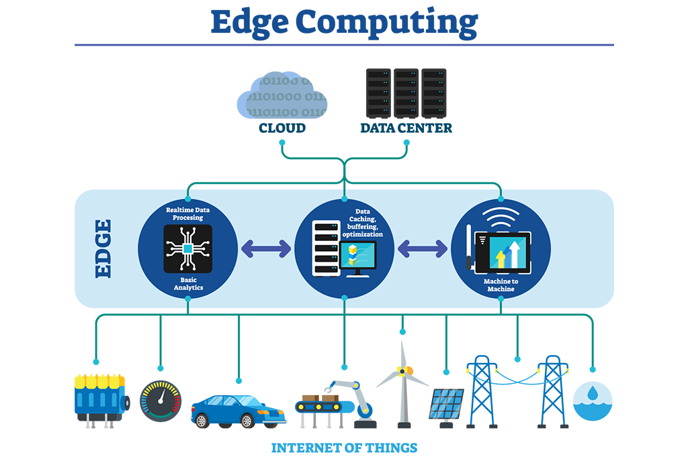
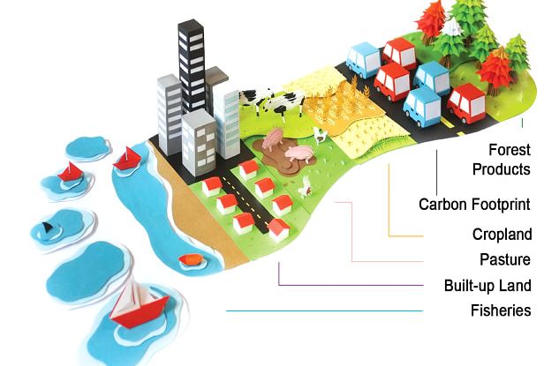
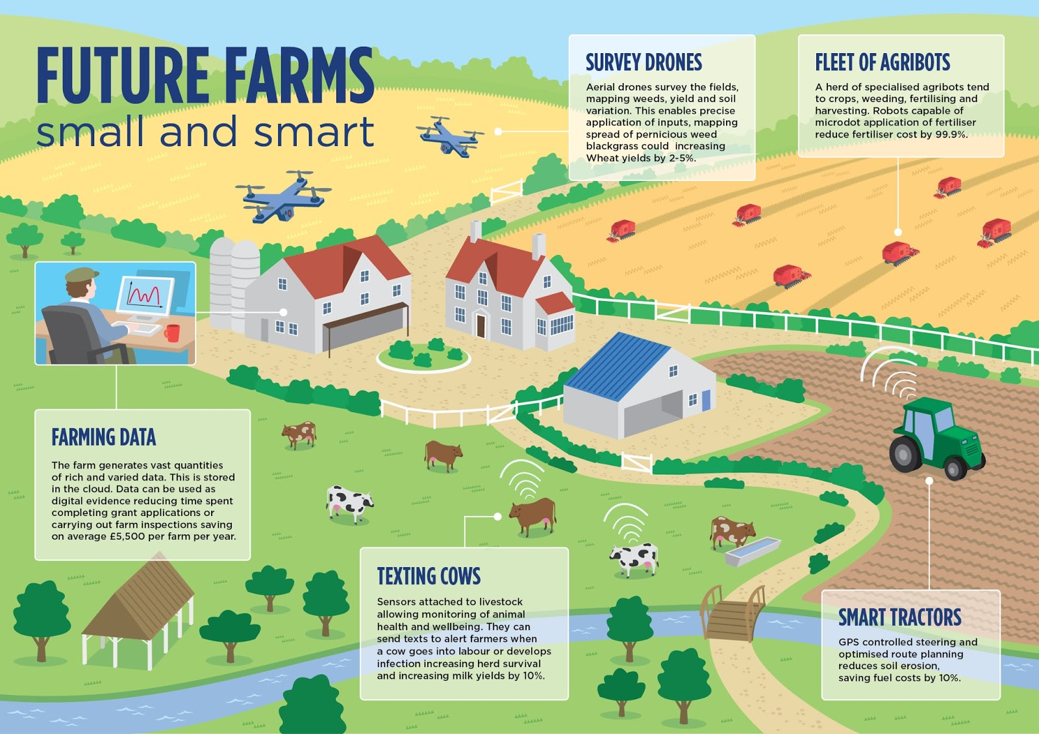
Highlights of Novel Ideas
Edge Computing: Implement edge computing techniques to process data closer to the source, reducing latency and enabling quicker decision-making without relying solely on centralized servers.
Smart Irrigation: Implement a closed-loop system that combines real-time soil moisture data with automated irrigation control, ensuring efficient water usage and minimizing waste.
Collaborative Farming Networks: Establish a network for neighboring farms to share data, insights, and resources, fostering collaboration and community-driven precision agriculture practices.
Carbon Footprint Analysis: Include a carbon footprint analysis tool that calculates and provides farmers with insights into the environmental impact of their agricultural practices, fostering sustainability.

Slide 11
Improvement Over Existing Methods
Efficiency in Resource Management
Traditional Methods: Limited data on environmental conditions and crop health, leading to suboptimal resource allocation.
Our Project: Real-time data from sensors enhances resource management, optimizing water usage, minimizing pesticide application, and maximizing overall efficiency.
Predictive Analytics
Traditional Methods: Reactive decision-making based on historical data with limited predictive capabilities.
Our Project: Algorithms analyze historical and real-time data for predictive insights, assisting farmers in making informed decisions.
Energy Optimization
Traditional Methods: Inefficient energy usage in conventional farming machinery.
Our Project: Implementation of energy-efficient strategies, including optimized sensor node functionality.
Scalability & Flexibility
Traditional Methods: Limited scalability and adaptability to technological advancements.
Our Project: Scalable architecture with the ability to incorporate future technologies, ensuring adaptability.

Slide 12
Summary
In the realm of precision agriculture, our project emerges as a beacon of innovation, harnessing the power of LoRa wireless sensor networks to revolutionize farming practices.
Commencing with the foundational hardware setup in September 2023, our journey unfolds through key milestones, each contributing to a paradigm shift in agricultural efficiency, sustainability, and data-driven decision-making.
The project seamlessly integrates diverse functionalities, including real-time data collection from sensors such as DHT11, PIR motion, and ultrasonic sensors.
This multi-sensor approach forms the basis for comprehensive insights, from environmental conditions to early disease detection.
The utilization of LoRa communication ensures seamless connectivity across vast agricultural landscapes.
"Green Fields, Smart Yields" is more than a project; it signifies a transformative journey toward a greener, smarter, and more sustainable future for agriculture, driven by technology, data, and a commitment to agricultural excellence.

